Slide 1
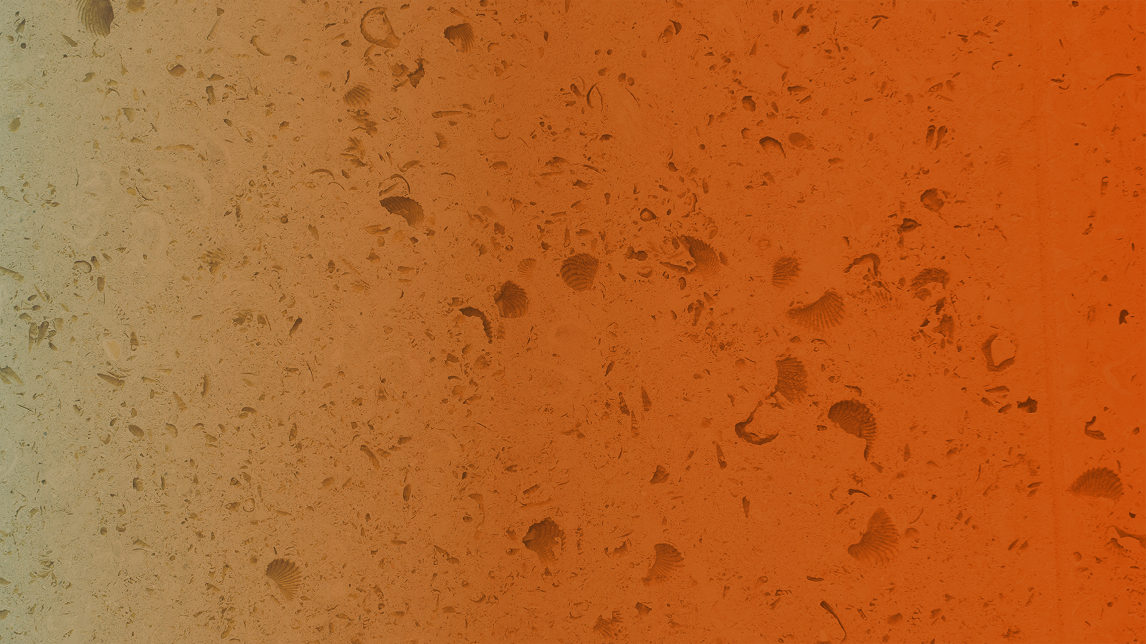

Fall 2018
Applied engineering Data analysis, optimization and visualization
Clustering data
Joshua Rhodes, PhD
Research Fellow/Adjunct Professor, The University of Texas at Austin

Slide 2
Midterm bonus
Given the quantity of questions, perhaps some questions were unclear
5 Bonus points if you edit the midterm questions to be more clear
Edit (track changes) the Word Doc file of the midterm in today’s module

Slide 3
Clustering data
A method of grouping like observations, persons, or activities
Why?
Sometimes there are natural groups in our data and we want to treat them differently, or figure out what makes them unique

Slide 4
Clustering is usually a first step before other machine learning tasks
Often an exploratory data analysis step
Become more familiar with your data
Identify “that is funny” or “I wonder why” angles for data analyses

Slide 5
Applications, continued
Recommendation engines
Market segmentation
Social network analysis
Search result grouping
Medical imaging
Image segmentation
Anomaly detection, etc…

Slide 6
There are multiple types of clustering (non-exhaustive list)
Centroid based: kmeans clustering
Minimize total distance between individuals and “centers”
Distribution and Density-based clustering
And who is my neighbor?
Hierarchical clustering
Agglomerative: bottom up
Divisive: top down

Slide 7
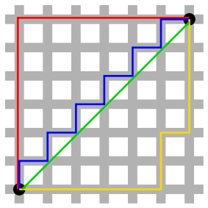
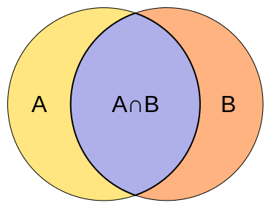
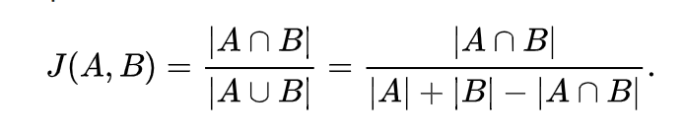
Multiple types of “distances”
Euclidean
Manhattan
Jaccard
Minkowski
Canberra, etc.
Notes:
https://www.datacamp.com/community/tutorials/hierarchical-clustering-R
Minkowski = a metric in a normed vector space which can be considered as a generalization of both the Euclidean distance and the Manhattan distance
Canberra = It is a weighted version of L₁ (Manhattan) distance.^{[3]} The Canberra distance has been used as a metric for comparing ranked lists^{[3]} and for intrusion detection in computer security.

Slide 8

kmeans clustering

Slide 9
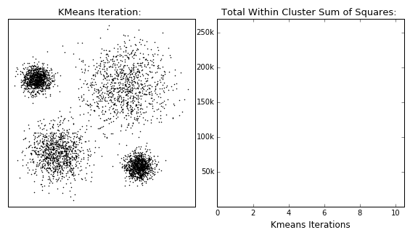
kmeans – now with more GIF!

Slide 10
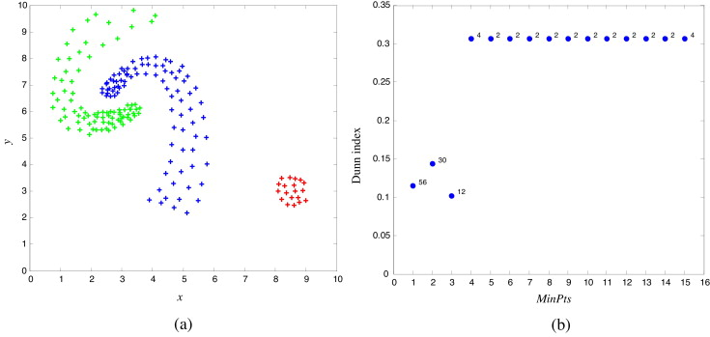
Proximity/density based clustering

Slide 11
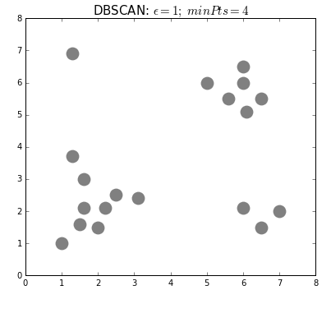
Density-based clustering GIF
R package:
dbscan

Slide 12
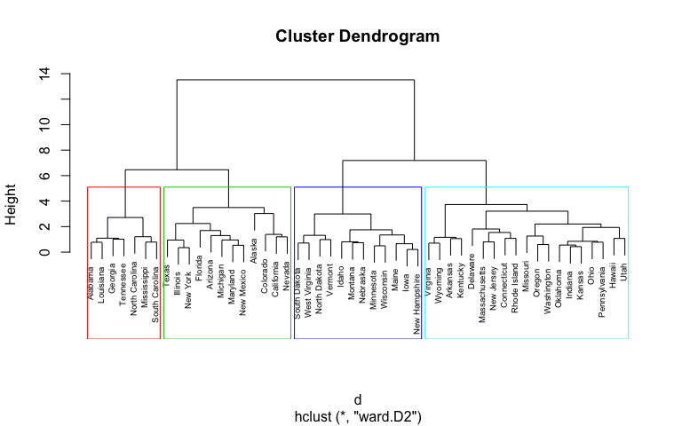
Hierarchical clustering

Slide 13

Hierarchical clustering, now with more GIF

